Slide 1
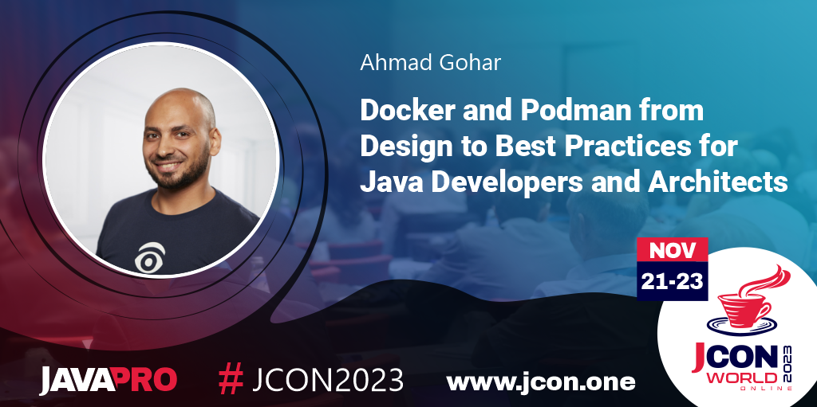

Slide 2
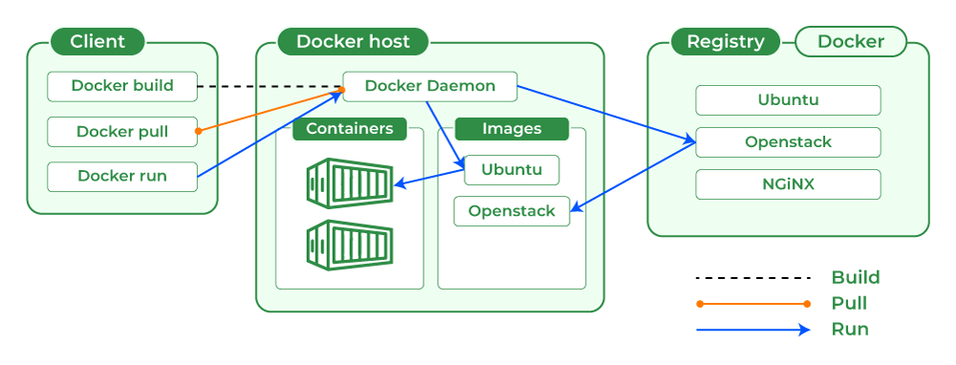
Container image, client, host, and Registry

Slide 3
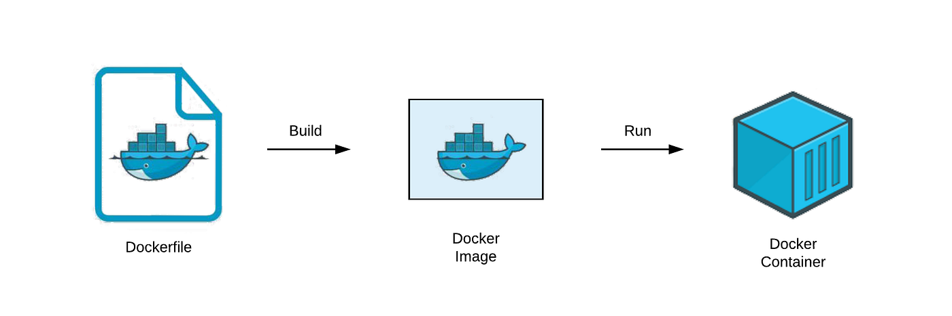
Docker/Container Image
Dockerfile
Automating a Cloud Native Environment
Skinny
Buildpacks
Thin
Hollow
Fat/Uber
Goole Jib
. . .

Slide 4
Dockerfile Architecture/Design Best Practices
For Java Applications

Slide 5
Dockerfile | Best Practices 1- Use Explicit Versions and deterministic Docker base image tags ("latest" is not a version!)
- BAD PRACTICE
FROM ubuntu:latest
COPY . /app
RUN make /app
CMD python /app/app.py
- BEST PRACTICE
FROM ubuntu:22.04
COPY . /app
RUN make /app
CMD python /app/app.py

Slide 6
Dockerfile | Best Practices 2- Use deterministic Docker base image tags
- BAD PRACTICE # Simple Java Container
FROM maven
RUN mkdir /app
WORKDIR /app
COPY . /app
RUN mvn clean install
CMD "mvn" "exec:java”
- BEST PRACTICE # The deterministic Docker base image tags
FROM maven:3.6.3-jdk-11-slim@sha256:68ce1cd457891f48d1e137c7d6a4493f60843e84c9e2634e3df1d3d5b381d36c
RUN mkdir /app
WORKDIR /app
COPY . /app
RUN mvn clean package -DskipTests

Slide 7
Dockerfile | Best Practices 3- Separate configuration from code
Separate configuration from code | HOW TO DO IT IN JAVA
Mount a volume containing configuration files | e.g. Read .properties files
Set environment variables in the container | e.g. Use System.getEnv() or features provided by your app framework
Use a network-based configuration service | e.g. Spring Cloud Config
Give arguments to the JVM on startup by overriding the container’s entrypoint | e.g. Use System.getProperty or features provided by your app framework

Slide 8
Dockerfile | Best Practices 4- Multi-stage builds for your Java container
FROM maven:3.6.3-jdk-11-slim@sha256:68ce1cd457891f48d1e137c7d6a4493f60843e84c9e2634e3df1d3d5b381d36c AS build
RUN mkdir /project
COPY . /project
WORKDIR /project
RUN mvn clean package -DskipTests
FROM adoptopenjdk/openjdk11:jre-11.0.9.1_1-alpine@sha256:b6ab039066382d39cfc843914ef1fc624aa60e2a16ede433509ccadd6d995b1f
RUN mkdir /app
COPY --from=build /project/target/java-application.jar /app/java-application.jar
WORKDIR /app
CMD "java" "-jar" "java-application.jar"

Slide 9
Dockerfile | Best Practices 5- Don’t run containers as root
- BAD PRACTICE
FROM maven:3.6.3-jdk-11-slim@sha256:68ce1cd457891f48d1e137c7d6a4493f60843e84c9e2634e3df1d3d5b381d36c AS build
RUN mkdir /project
COPY . /project
WORKDIR /project
RUN mvn clean package -DskipTests
- BEST PRACTICE
FROM adoptopenjdk/openjdk11:jre-11.0.9.1_1-alpine@sha256:b6ab039066382d39cfc843914ef1fc624aa60e2a16ede433509ccadd6d995b1f
RUN mkdir /app
RUN addgroup --system javauser && adduser -S -s /bin/false -G javauser javauser
COPY --from=build /project/target/java-application.jar /app/java-application.jar
WORKDIR /app
RUN chown -R javauser:javauser /app
USER javauser
CMD "java" "-jar" "java-application.jar"

Slide 10
Dockerfile | Best Practices 6- Properly handle events to safely terminate a Java Docker web application
FROM maven:3.6.3-jdk-11-slim@sha256:68ce1cd457891f48d1e137c7d6a4493f60843e84c9e2634e3df1d3d5b381d36c AS build
RUN mkdir /project
COPY . /project
WORKDIR /project
RUN mvn clean package -DskipTests
FROM adoptopenjdk/openjdk11:jre-11.0.9.1_1-alpine@sha256:b6ab039066382d39cfc843914ef1fc624aa60e2a16ede433509ccadd6d995b1f
RUN apk add dumb-init
RUN mkdir /app
RUN addgroup --system javauser && adduser -S -s /bin/false -G javauser javauser
COPY --from=build /project/target/java-code-workshop-0.0.1-SNAPSHOT.jar /app/java-application.jar
WORKDIR /app
RUN chown -R javauser:javauser /app
USER javauser
CMD "dumb-init" "java" "-jar" "java-application.jar"

Slide 11
Dockerfile | Best Practices 6- Properly handle events to safely terminate a Java Docker web application
App.java
# Graceful tear down for your Java web applications
Runtime.getRuntime().addShutdownHook(new Thread() {
@Override
public void run() {
System.out.println("Inside Add Shutdown Hook");
}
});

Slide 12
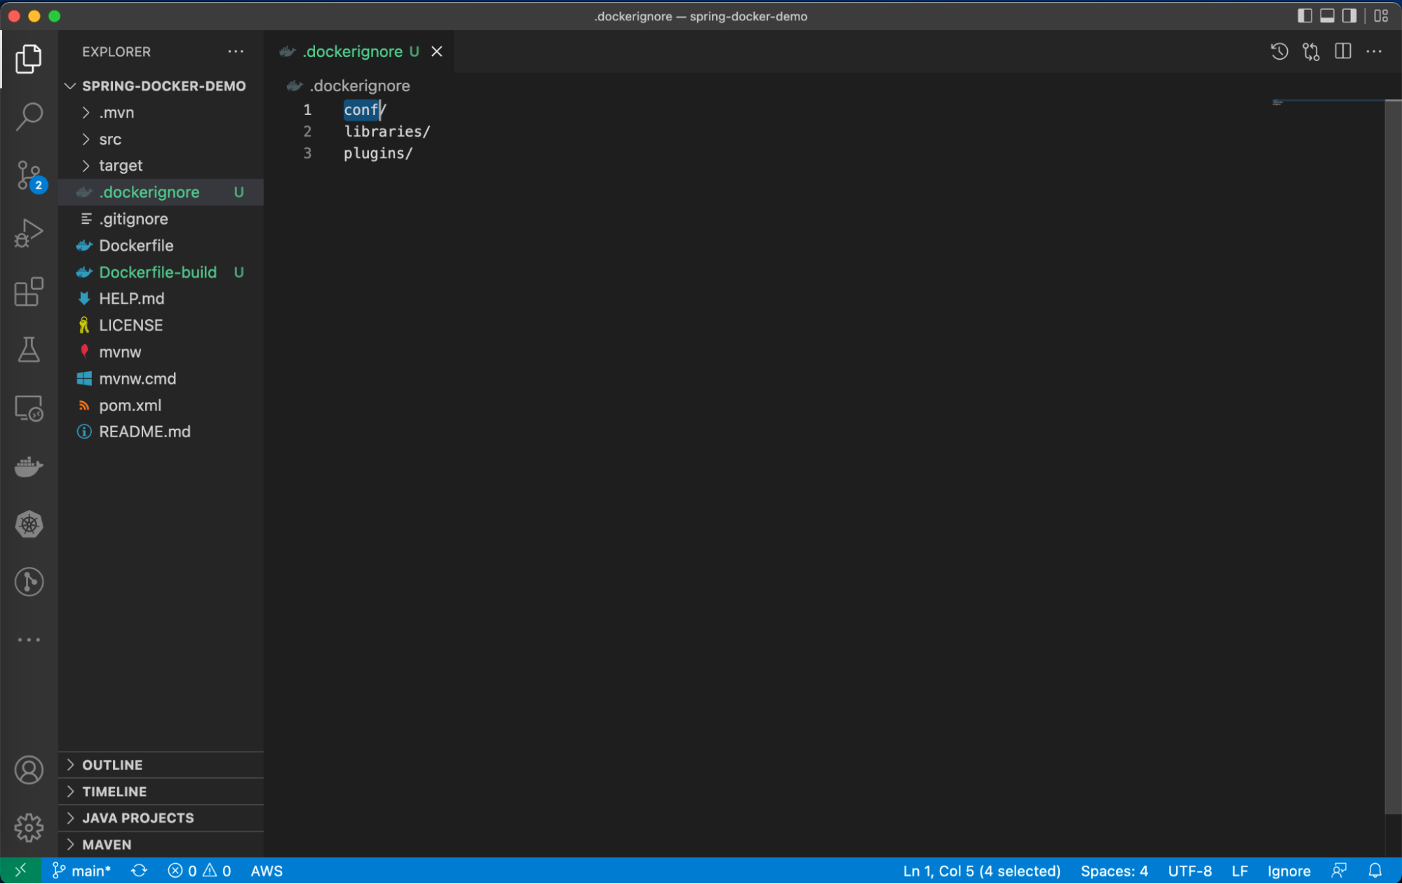
Dockerfile | Best Practices 7- Keeping unnecessary files out of your Java container images
.dockerignore
**/*.log
Dockerfile
.git
.gitignore

Slide 13
Dockerfile | Best Practices 8- Make sure Java is container-aware
-XX:MaxRAMPercentage=50
-XshowSettings:vm –version
-XX:+UnlockExperimentalVMOptions
-XX:+UseCGroupMemoryLimitForHeap
It's not recommended to use Java version before 8u121 in the container environment.

Slide 14
Dockerfile | Best Practices 9- How to avoid long build time 9.a- Put static layers at the top and changing layers at the bottom of the docker file
- BAD PRACTICE
COPY lib/* /deployment/lib/
COPY sample-runner.jar /deployment/
RUN apt-get update
RUN apt-get -y install openjdk-8-jdk ssh vim
- BEST PRACTICE
RUN apt-get update
RUN apt-get -y install openjdk-8-jdk ssh vim
COPY lib/* /deployment/lib/
COPY sample-runner.jar /deployment/

Slide 15
Dockerfile | Best Practices 9- How to avoid long build time 9.b- Copy files with specific names
- BAD PRACTICE
COPY *-runner.jar /deployment/
- BEST PRACTICE
COPY sample-runner.jar /deployment/app.jar

Slide 16
Dockerfile | Best Practices 9- How to avoid long build time 9.c- Group layers
- BAD PRACTICE
RUN apt-get update RUN apt-get -y install openjdk-8-jdk ssh vim - BEST PRACTICE
RUN apt-get update \
&& apt-get -y install \
openjdk-8-jdk ssh vim

Slide 17
Dockerfile | Best Practices 10- How to get rid of huge image size 10.a- Use flag --no-install-recommends for apt-get command
- BAD PRACTICE
RUN apt-get -y install openjdk-8-jdk - BEST PRACTICE
RUN apt-get -y install --no-install-recommends openjdk-8-jdk

Slide 18
Dockerfile | Best Practices 10- How to get rid of huge image size 10.b- Remove cache of your apt manager
- BAD PRACTICE
RUN apt-get update \
&& apt-get -y install --no-install-recommends openjdk-8-jdk - BEST PRACTICE
RUN apt-get update \
&& apt-get -y install --no-install-recommends openjdk-8-jdk
&& rm -rf /var/lib/apt/lists/*

Slide 19
Dockerfile | Best Practices 11- How to stay away from hard maintainability 11.a- Use specific images
- BAD PRACTICE
FROM debian:stretch
- BEST PRACTICE
FROM openjdk

Slide 20
Dockerfile | Best Practices 11- How to stay away from hard maintainability 11.b- Always specify base image tag
- BAD PRACTICE
FROM openjdk
- BEST PRACTICE
FROM openjdk:8

Slide 21
Dockerfile | Best Practices 11- How to stay away from hard maintainability 11.c- Use JRE if you don't need to build your application
- BAD PRACTICE
FROM openjdk:8
- BEST PRACTICE
FROM openjdk:8-jre-alpine

Slide 22
Dockerfile | Best Practices 13- Use a Java framework designed for containers
Spring Boot
https://docs.spring.io/spring-boot/docs/current/reference/html/executable-jar.html
Quarkus
Micronaut

Slide 23

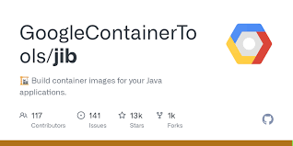
Dockerfile | Best Practices 14- Use a Java plugins for containers generation
Buildpacks
Google Jib
Others . . .

Slide 24
Automating a Cloud Native Environment Buildpacks
mvn spring-boot:build-image
docker image push docker.io/ansgohar/user-profile-ms:v1.5

Slide 25
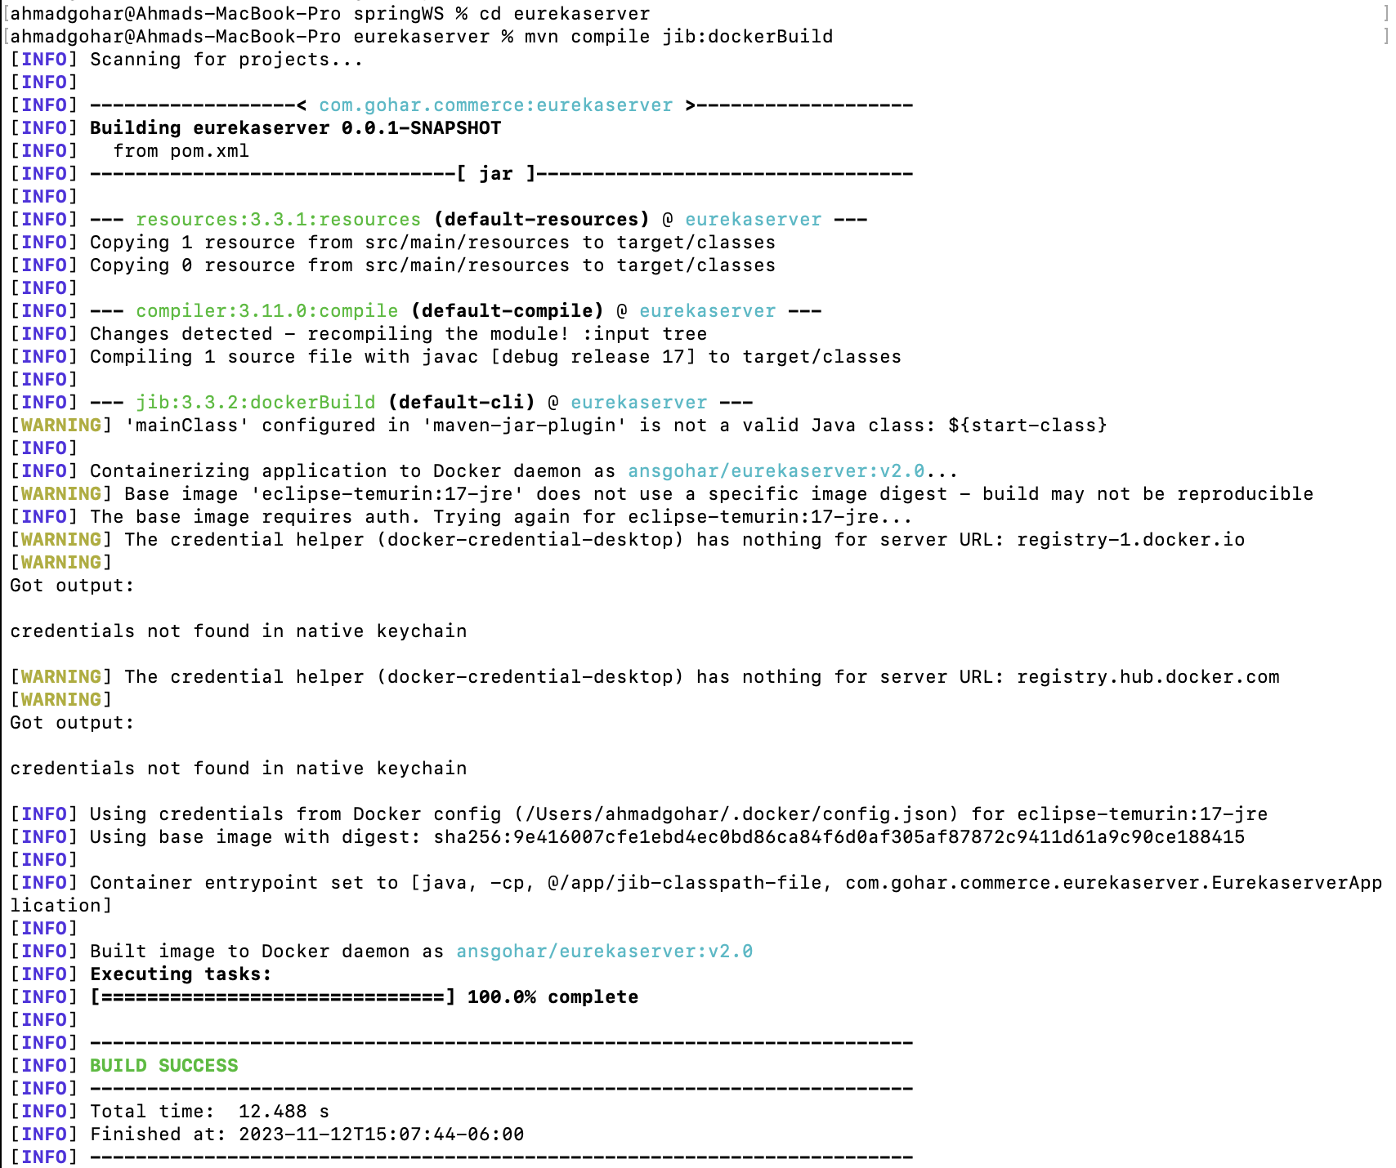
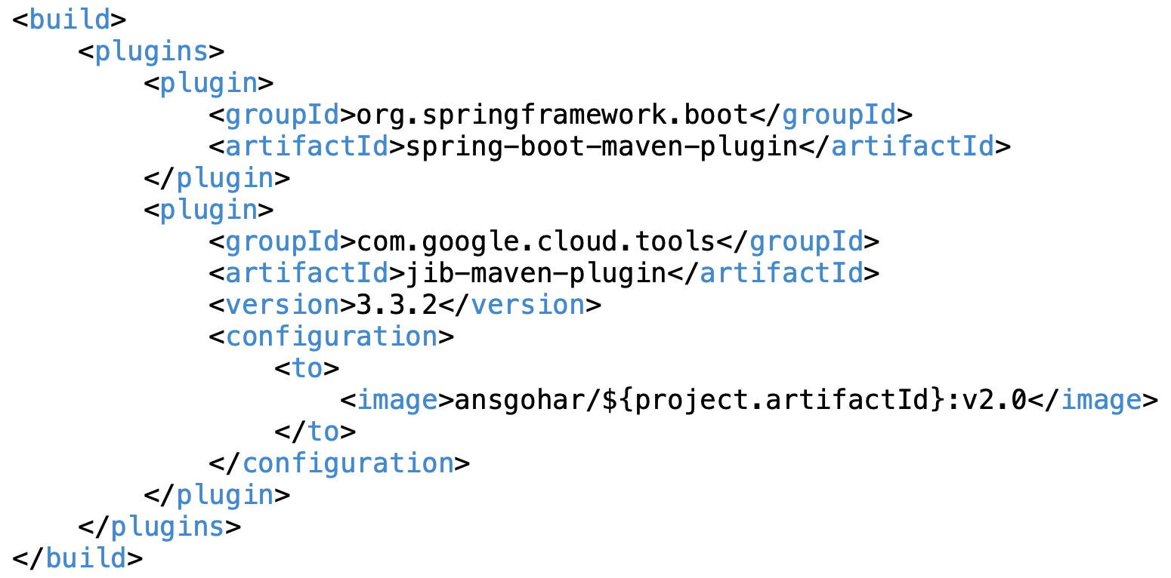
Automating a Cloud Native Environment Google Jib
mvn compile jib:dockerBuild
docker image push docker.io/ansgohar/user-profile-ms:v2.0

Slide 26
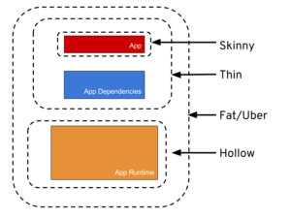
Docker Image
Skinny
Contains ONLY the bits you literally type into your code editor, and NOTHING else.
Thin
Contains all of the above PLUS the app’s direct dependencies of your app (db drivers, utility libraries, etc).
Hollow
The inverse of Thin - Contains only the bits needed to run your app but does NOT contain the app itself. Basically a pre-packaged “app server” to which you can later deploy your app, in the same style as traditional Java EE app servers, but with important differences, we’ll get to later.
Fat/Uber
Contains the bit you literally write yourself PLUS the direct dependencies of your app PLUS the bits needed to run your app “on its own”.

Slide 27
Container Engine

Slide 28
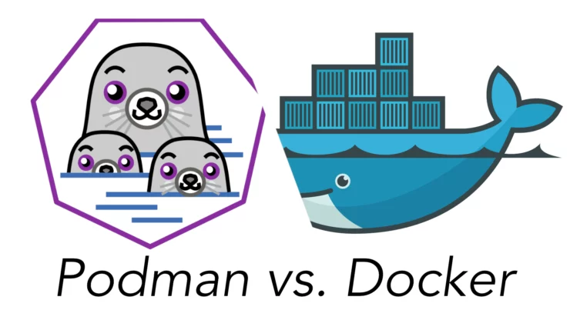

Slide 29
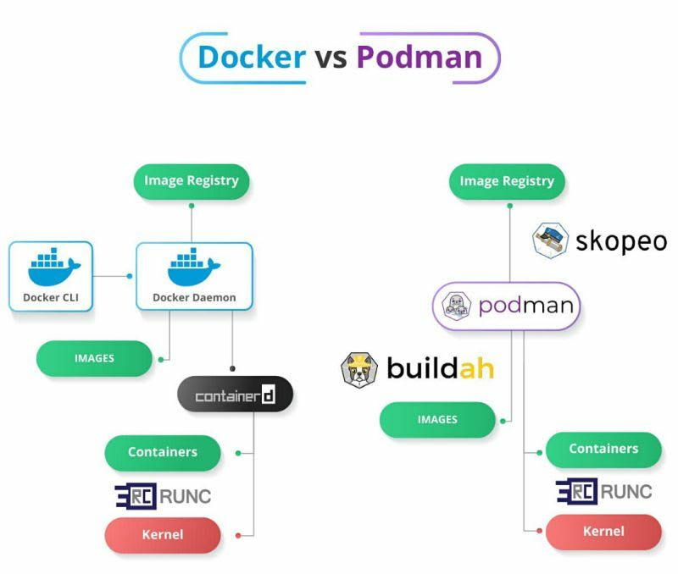

Slide 30
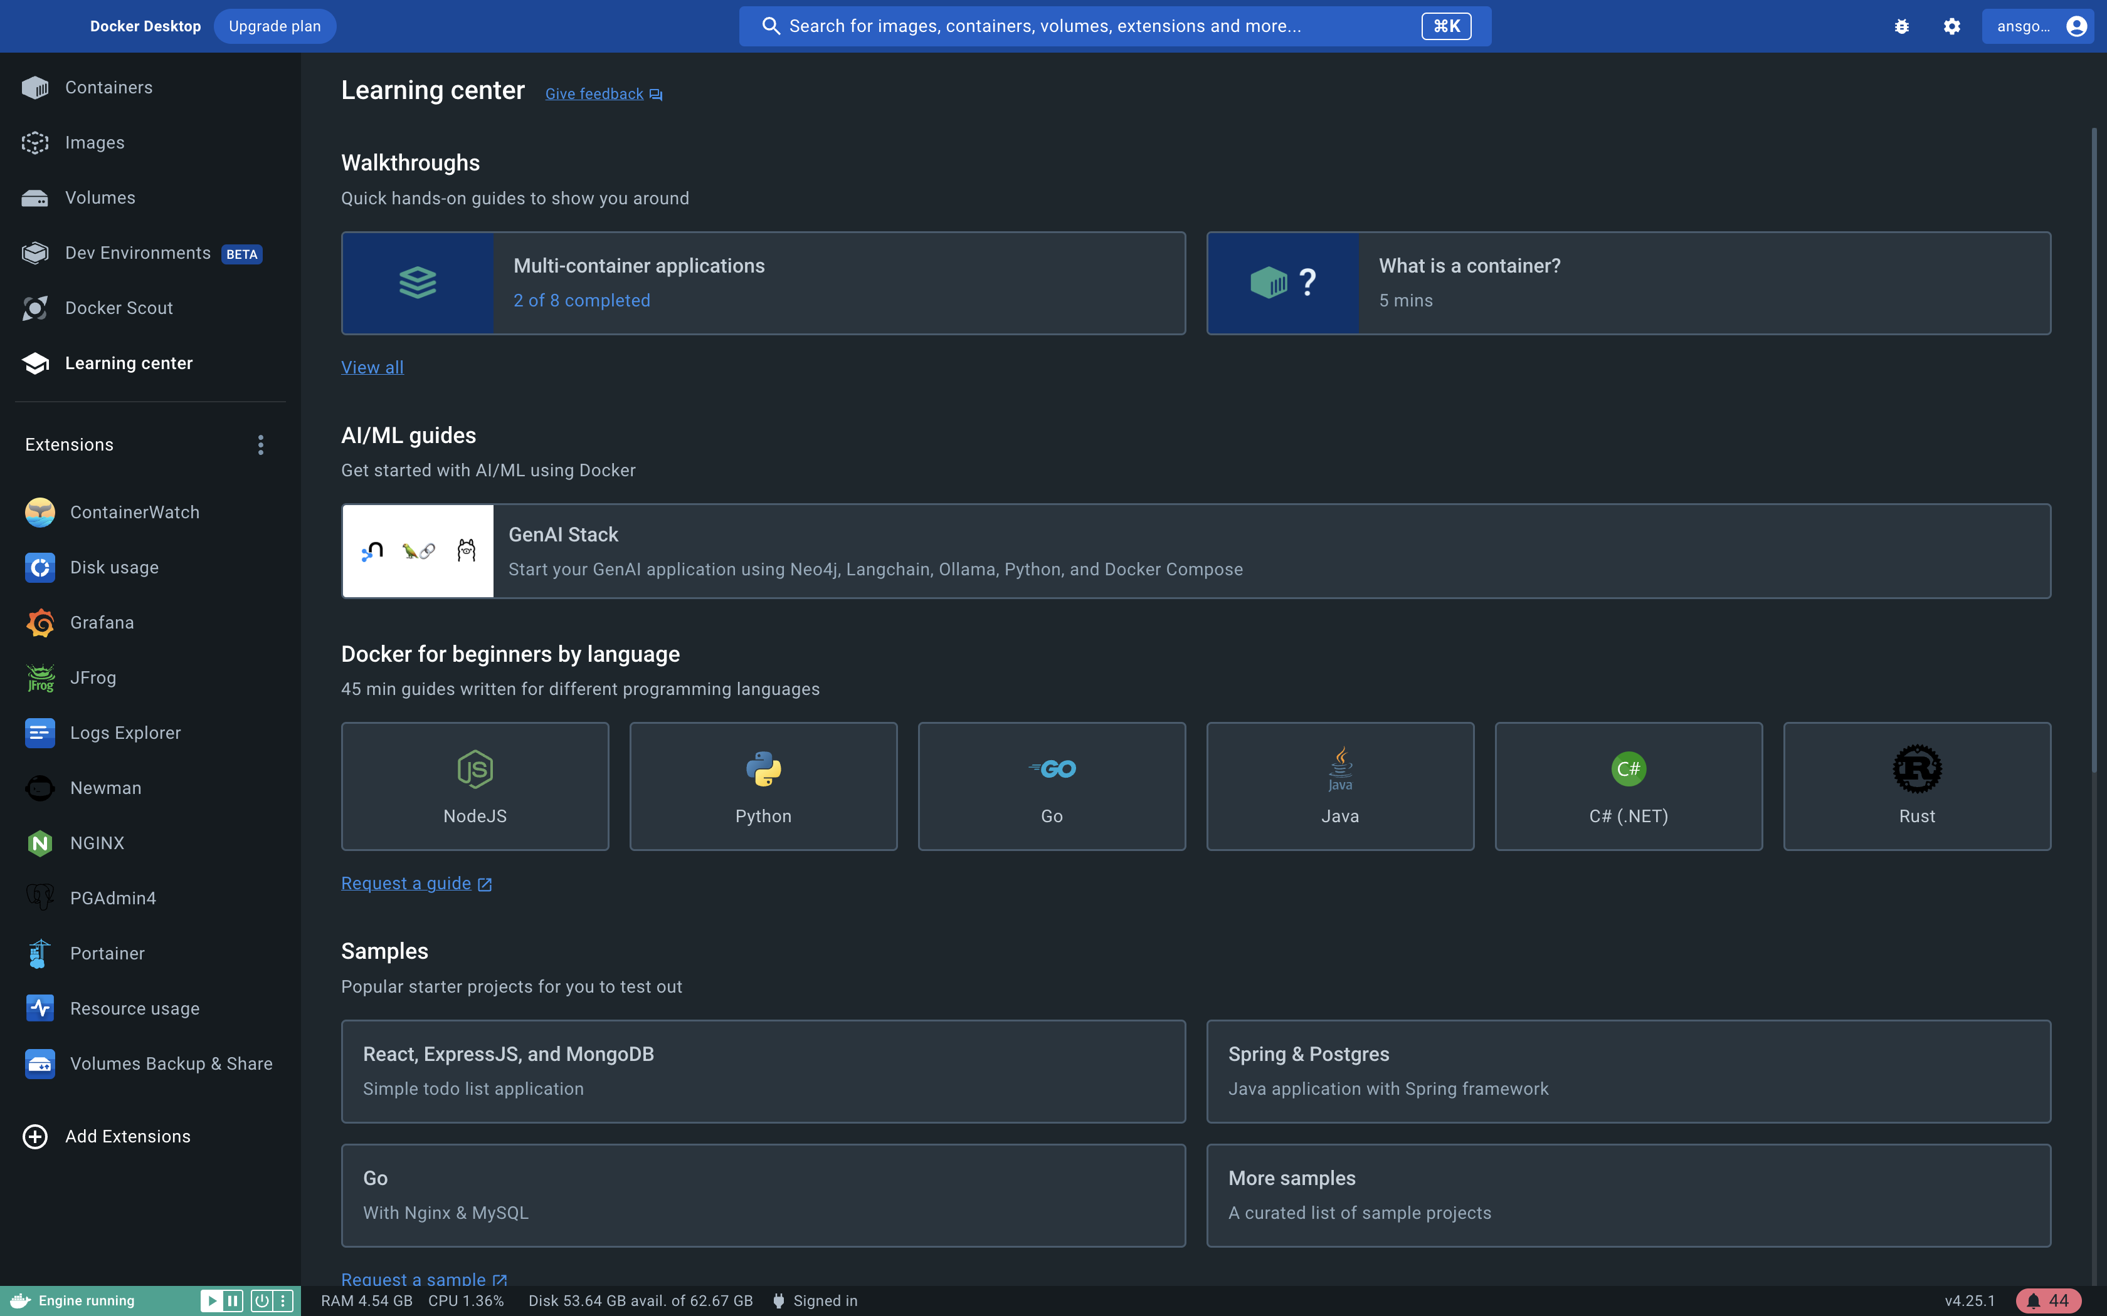

Slide 31
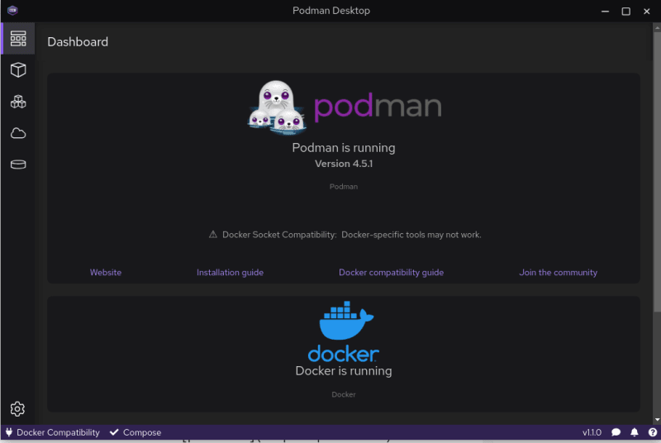

Slide 32


Slide 33
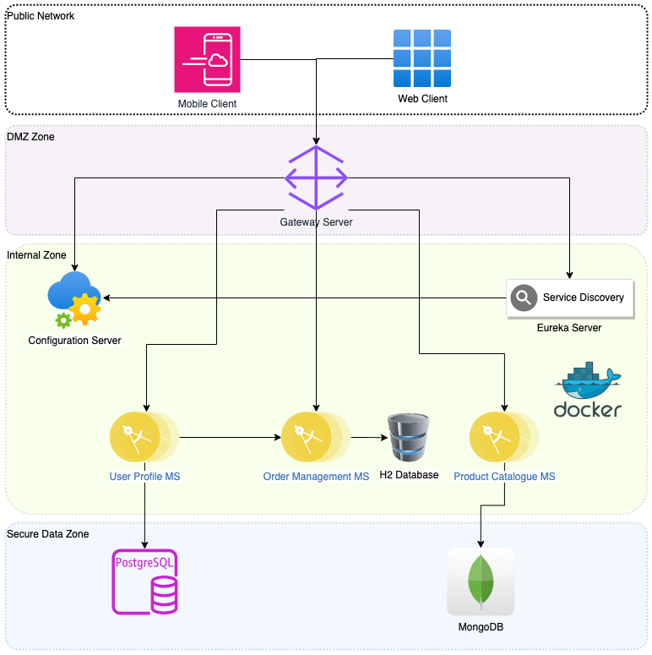
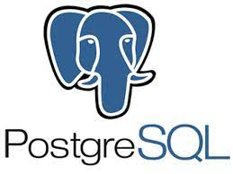


Slide 34
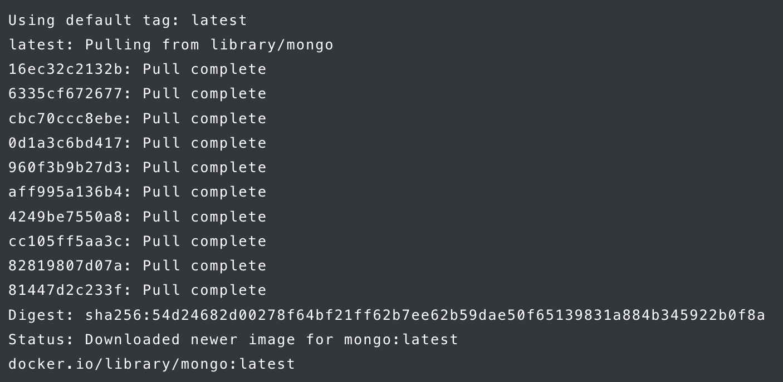
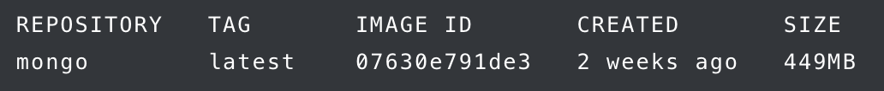
Install a MongoDB Docker Container
Download and install the MongoDB image from Docker Hub
sudo docker pull mongo
Ensure the image has been installed:
sudo docker images
Create a container with the mongo image in detached mode so that it is still interactive on your system:
sudo docker run --name mongo_example -d mongo
Ensure the container is running:
sudo docker ps

Slide 35
How to Log Into MongoDB on the Container
Enter the following to gain the bash prompt within the container:
sudo docker exec -it mongo_example bash
Once at the container’s command prompt, enter the mongosh shell:
mongosh
Create a container with the mongo image in detached mode so that it is still interactive on your system:
sudo docker run --name mongo_example -d mongo
Ensure the container is running:
sudo docker ps

Slide 36
Save MongoDB data from a Docker Container
Adding a Docker Volume to a MongoDB Container
Create a Docker Volume for the data to reside on by entering the following:
sudo docker volume create mongo_volume
Then create a docker run command to attach the volume to the container and map it to the /data/db container directory by entering:
sudo docker run -it -v mongo_volume:/data/db --name mongo_example4 -d mongo
Mounting a Host System Directory in a MongoDB Docker Container
Create a directory at the root level of your system by entering:
sudo mkdir -p /mongo_data_directory
Then execute a docker run command to mount the directory and map it to /data/db by entering:
sudo docker run -it -v /mongo_data_directory:/data/db --name mongo_example5 -d mongo

Slide 37
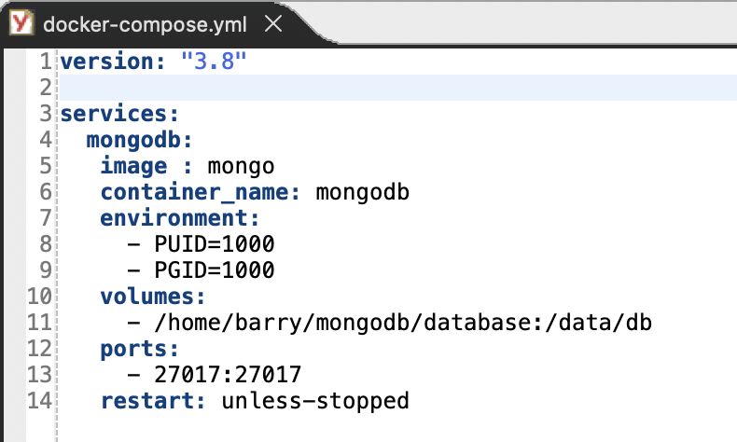
Build MongoDB using Docker Compose
Running the container(s)
Docker compose up
Destroy the container(s)
Docker compose down

Slide 38
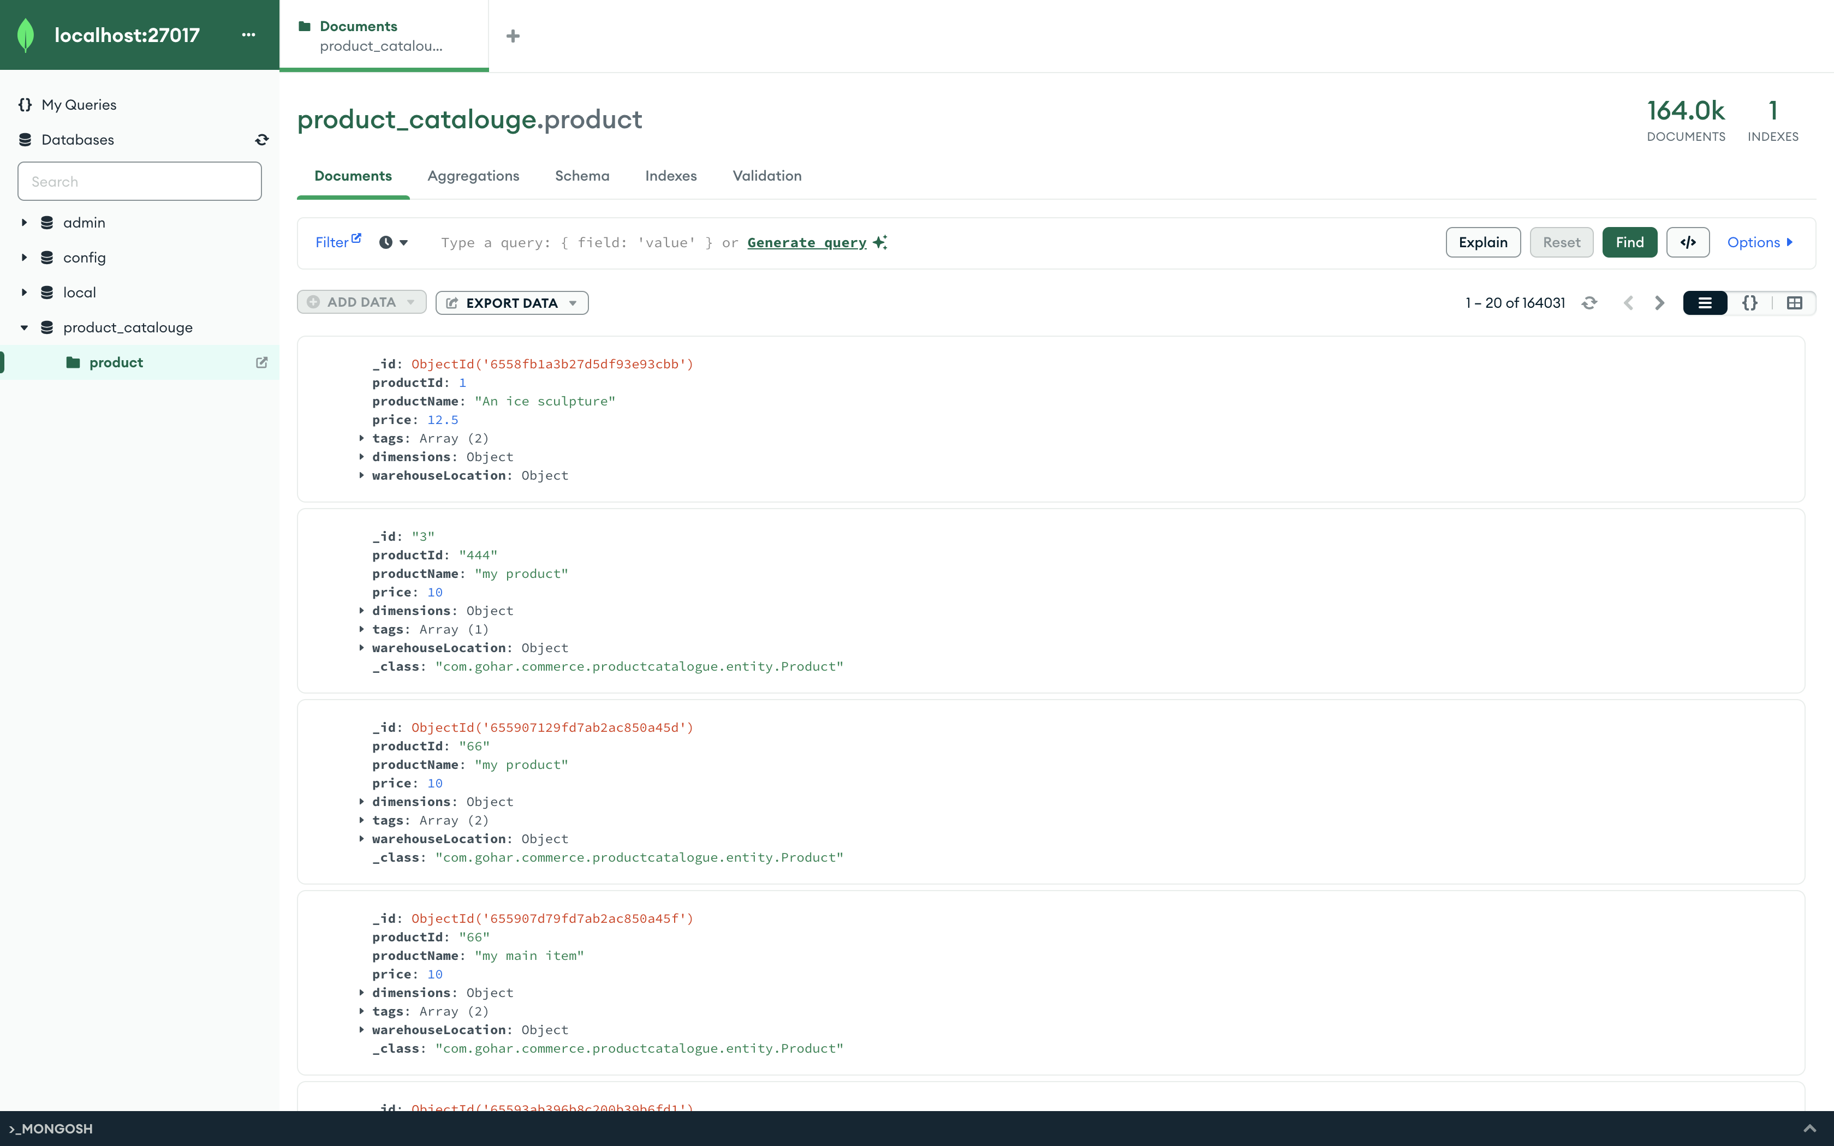

Slide 40
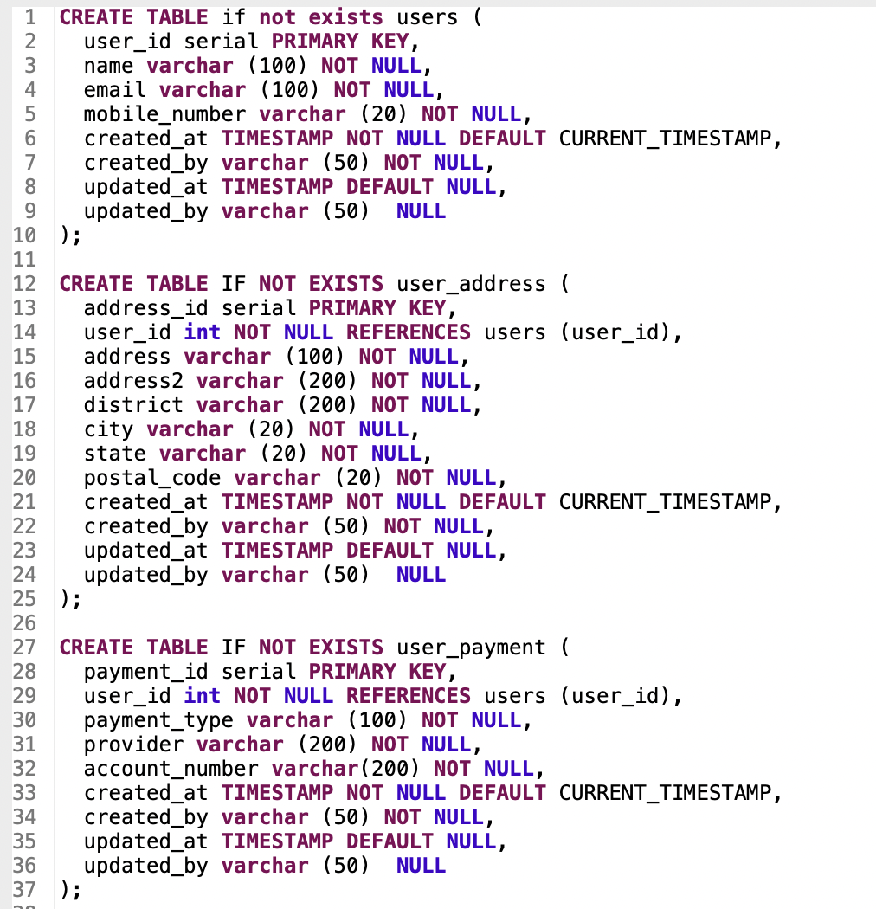
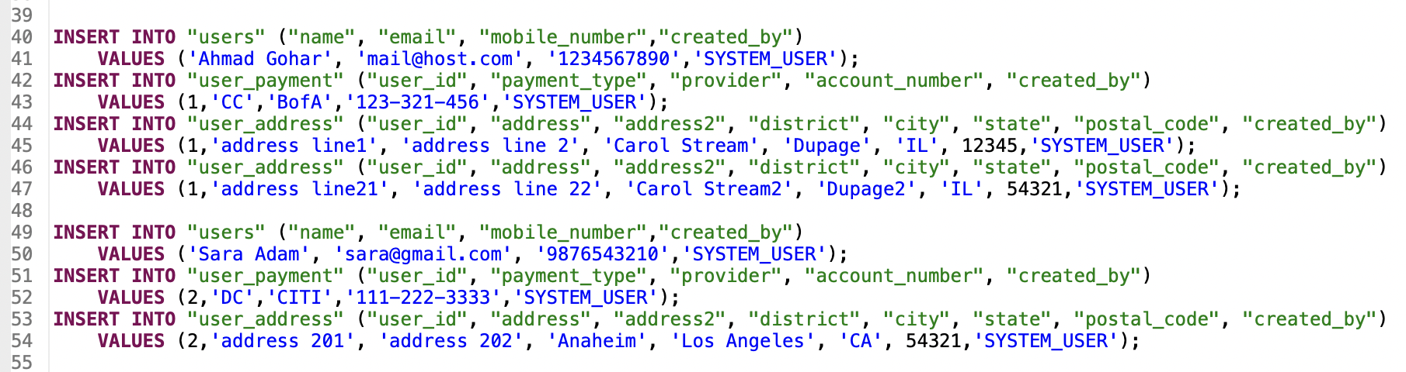
Database DDL & DML

Slide 41
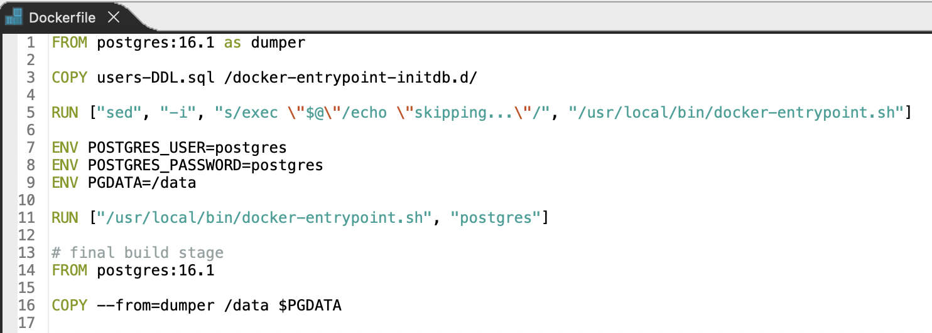
Postgres Dockerfile

Slide 42
Database DDL & DML
Build custom image
docker image build . -t preloaded_users_db:16.1_v1
Start a container with the generated image
docker container run -d --rm -p 5432:5432 -e POSTGRES_PASSWORD=postgres -e POSTGRES_USER=postgres --name preloaded_users_db preloaded_users_db:16.1_v1
Login to the database
psql -h localhost -U postgres
Display docker logs
docker container logs preloaded_users_db

Slide 43
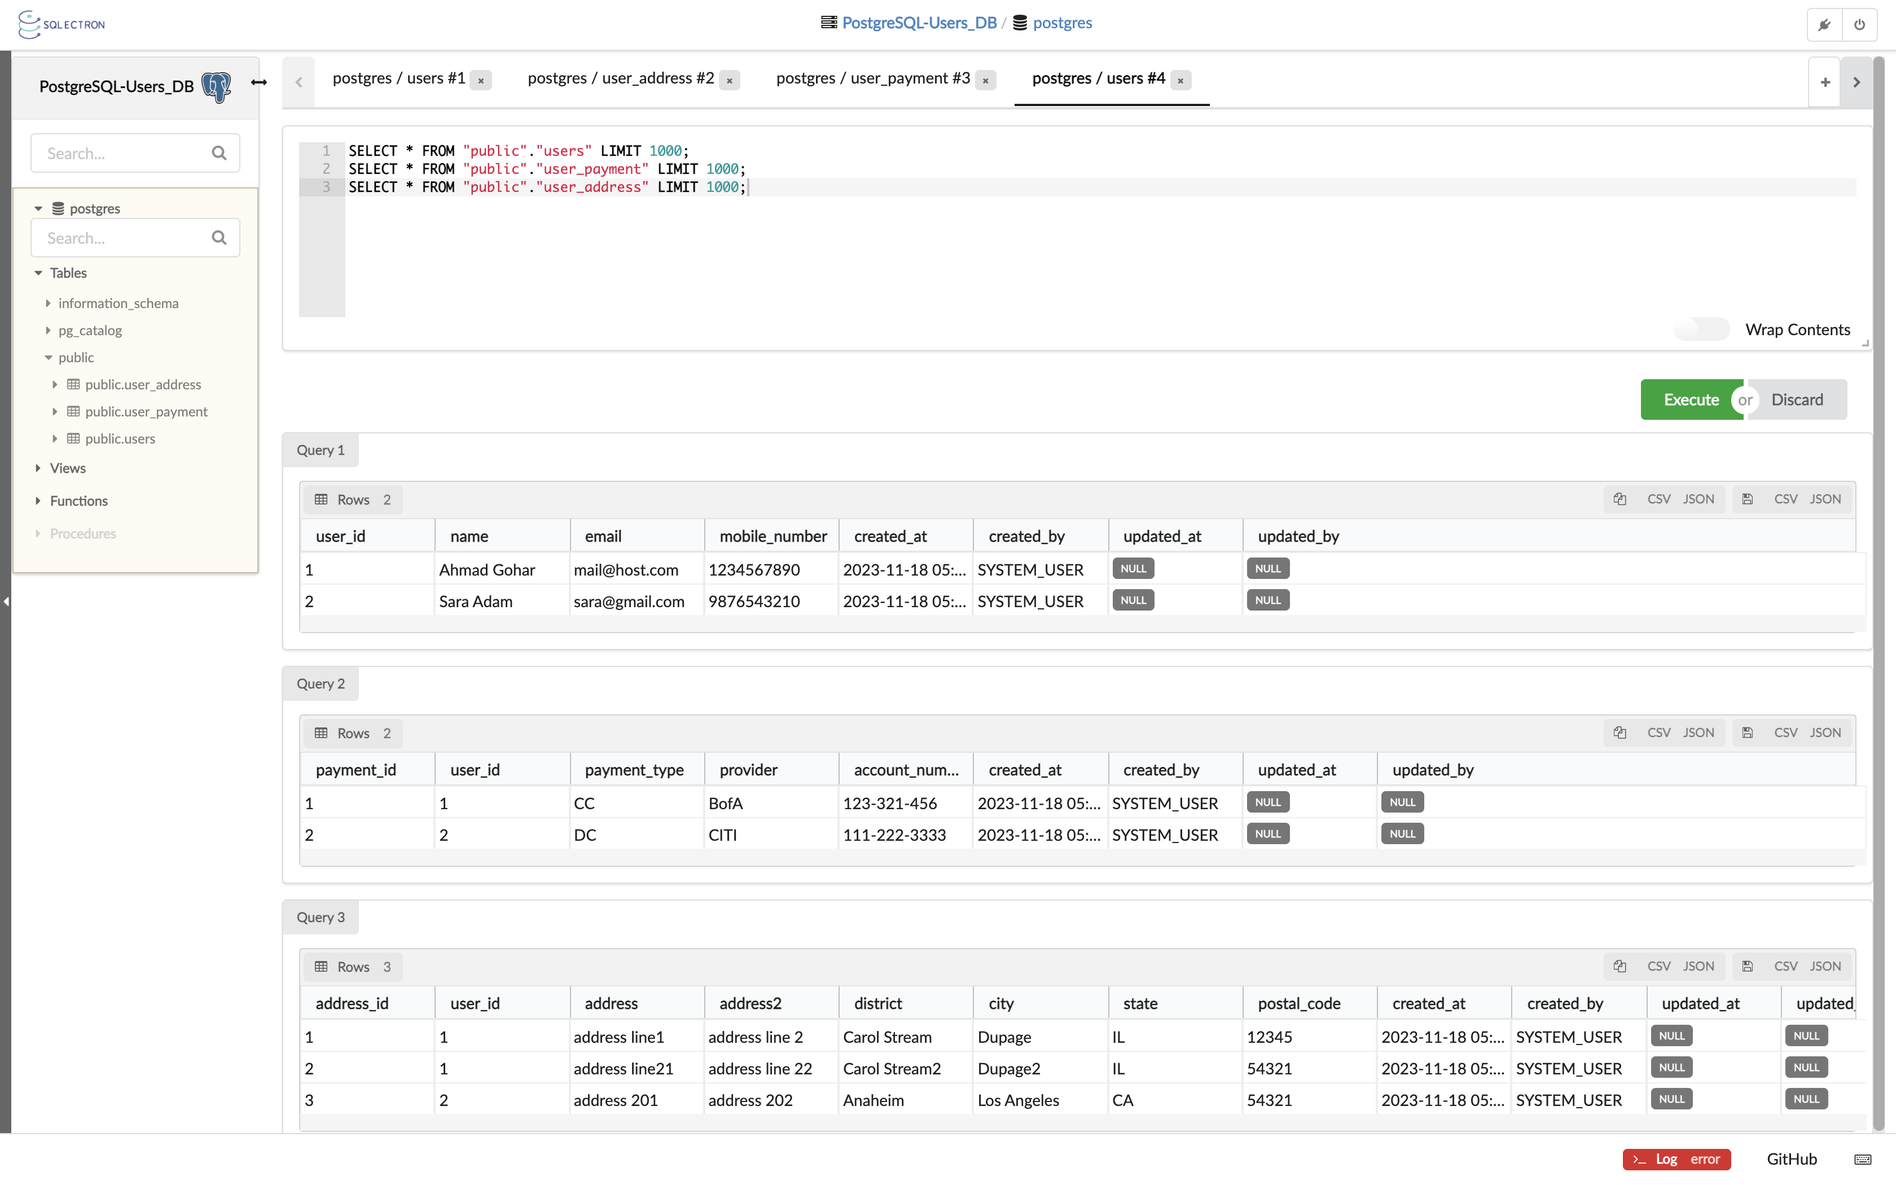

Slide 45
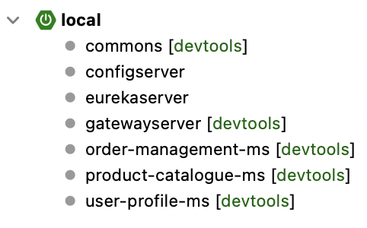

Slide 46
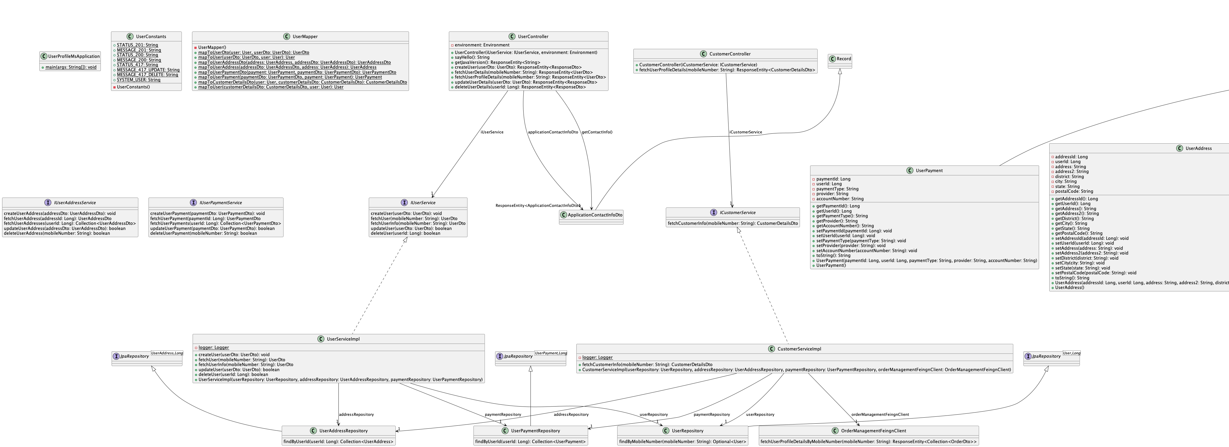
Microservice Design

Slide 47
Microservice Container Image Creation

Slide 48


